Slide 1
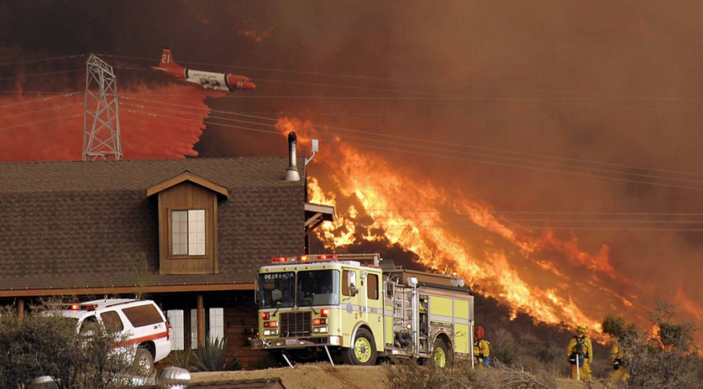
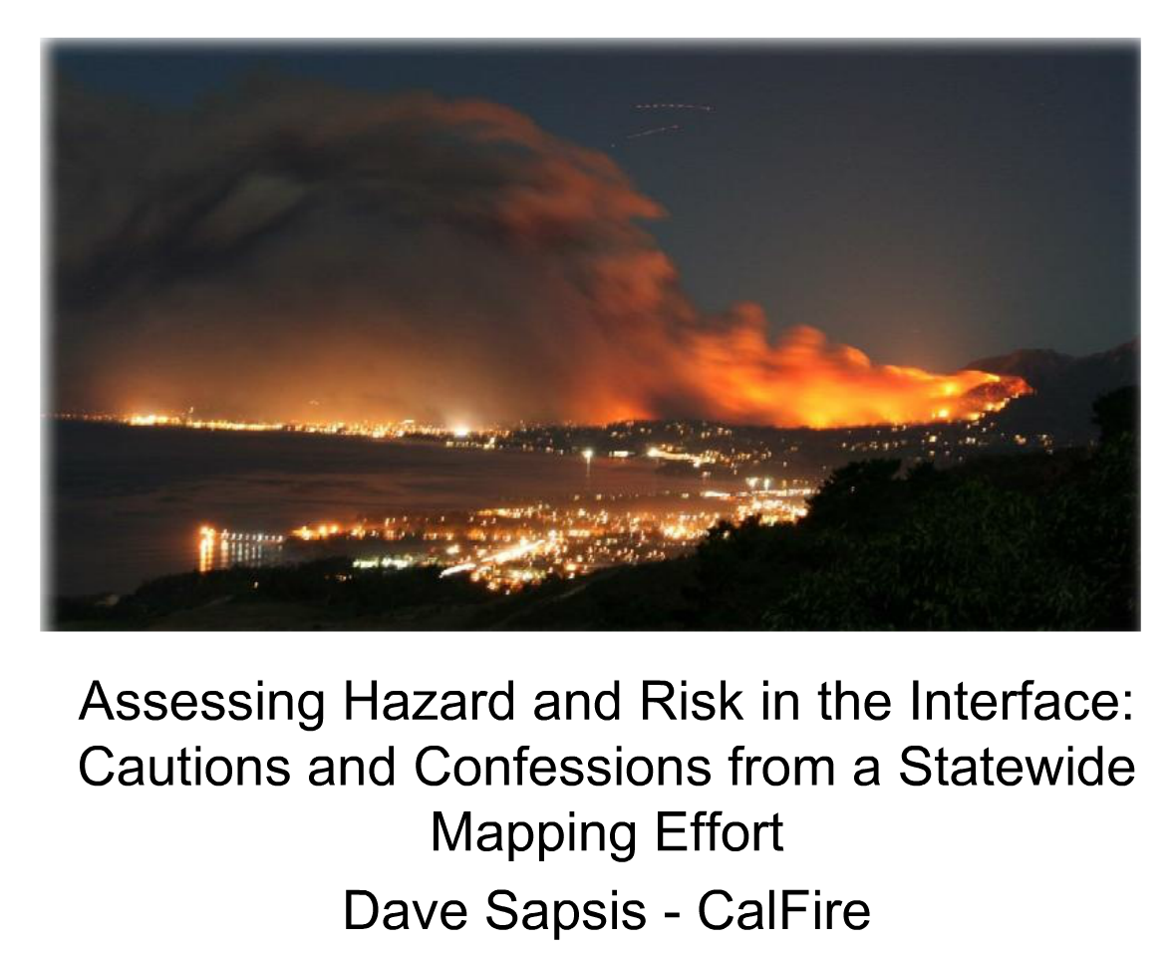
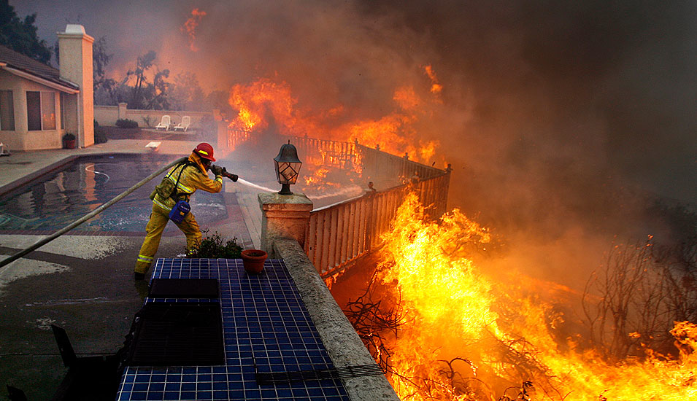
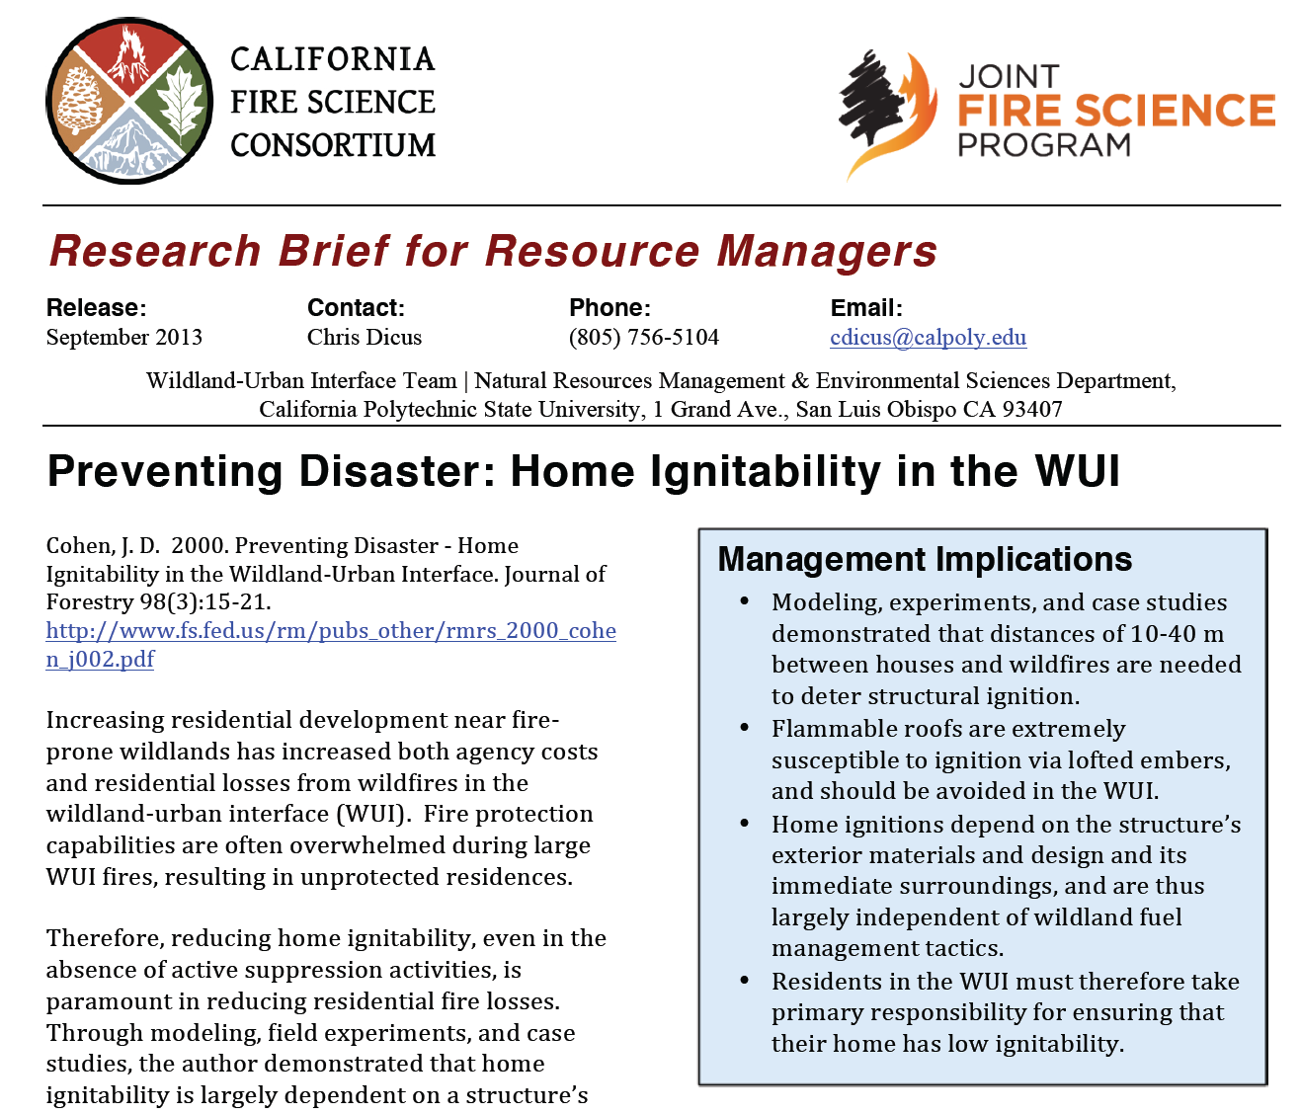
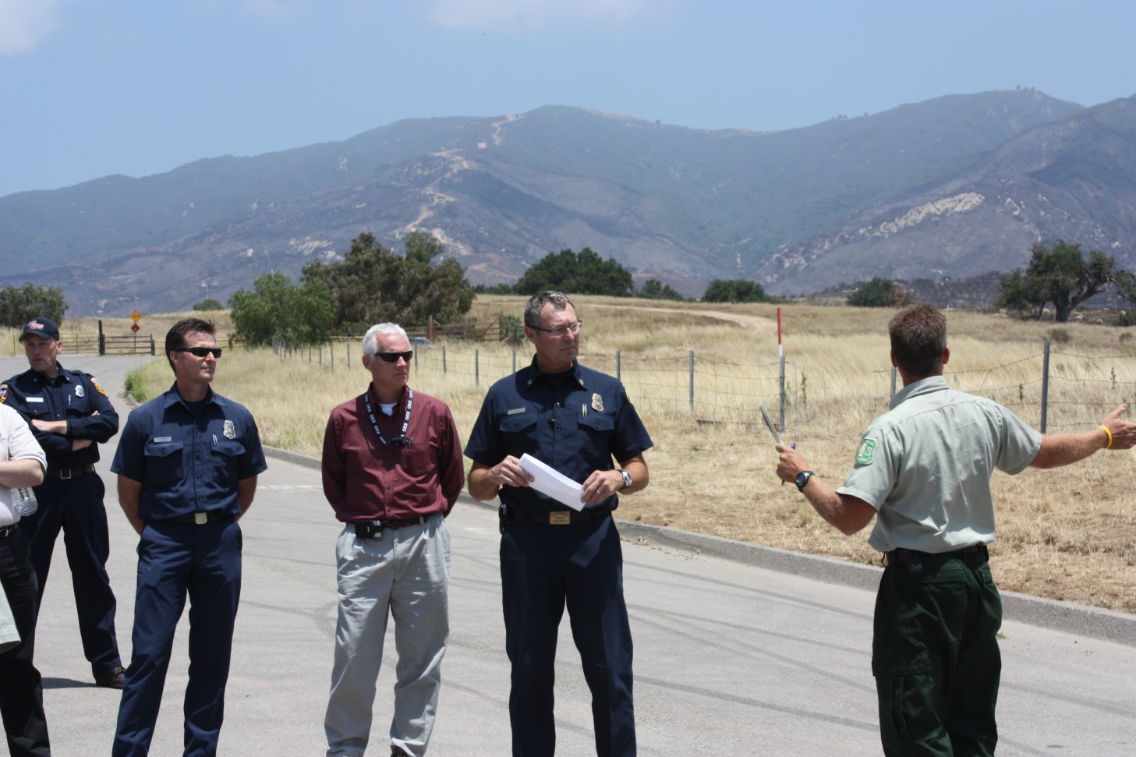
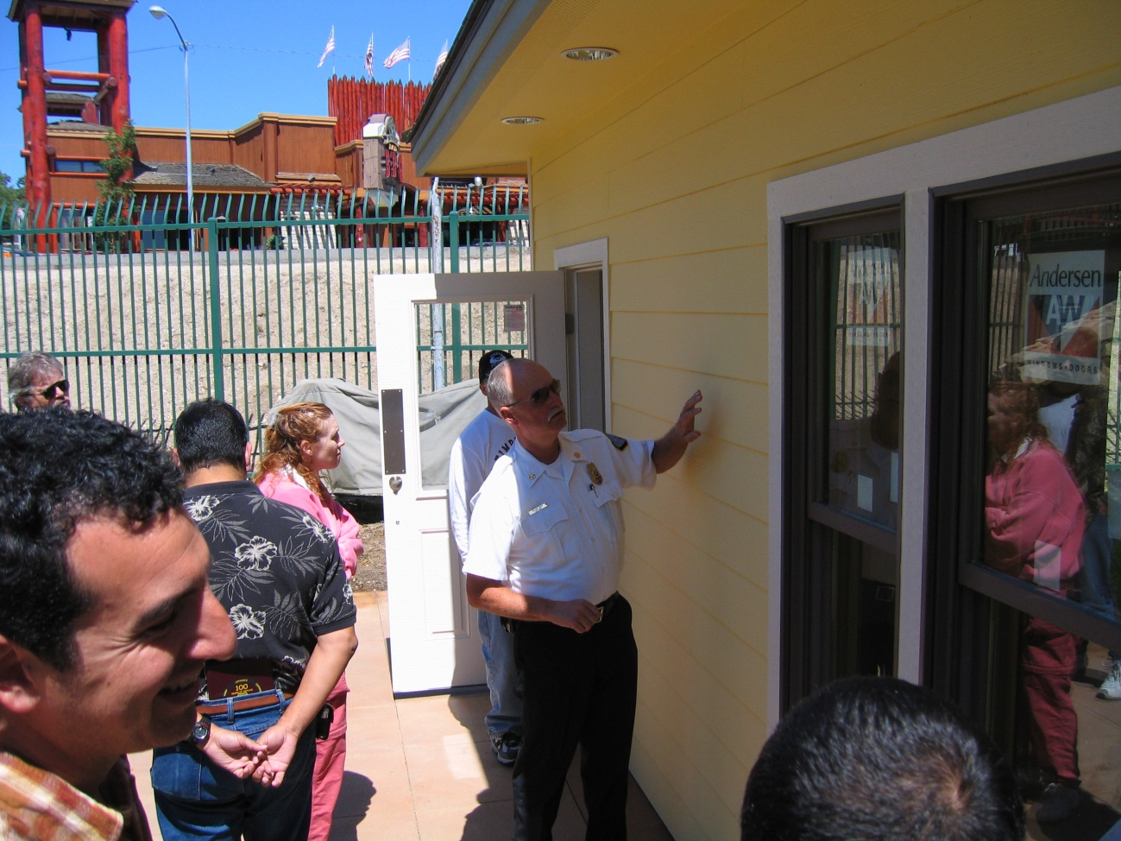
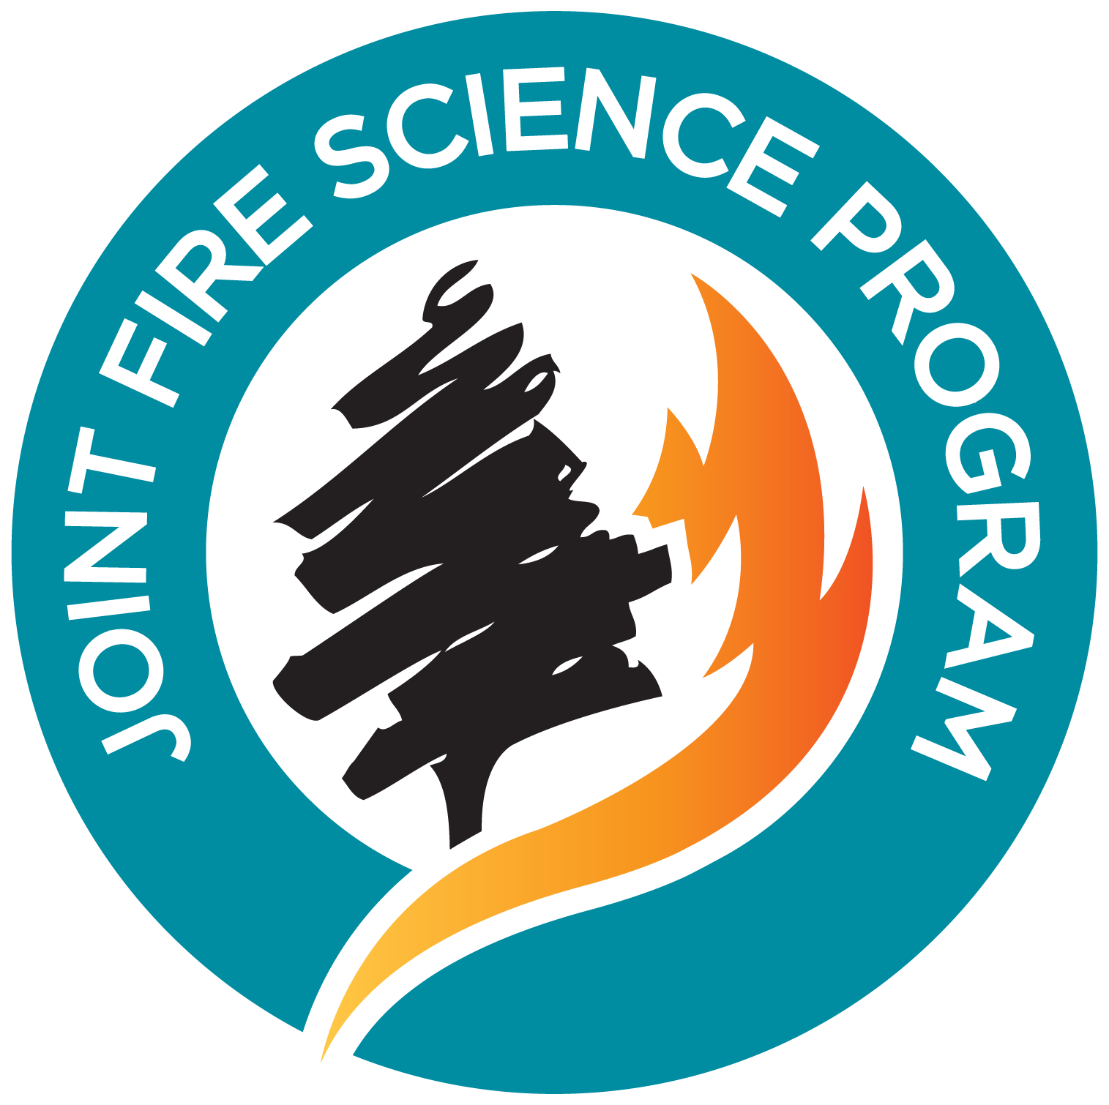
Wildland-Urban Interface Module Christopher A. Dicus, Dan R. Turner, Nicola C. Leyshon California Polytechnic State University, San Luis Obispo
What we do…
The WUI Module of the California Fire Science Consortium communicates relevant science in an easy-to-understand manner to the diverse stakeholders that play a role in WUI fire management. Cutting-edge science is disseminated by many means, including:
Online webinars
Research briefs
Annotated bibliography of scientific literature
Field tours
Seminars and workshops
Why we do it…
Unfortunately, there commonly seems to be a disconnect between scientists and the managers who implement their findings. The California Fire Science Consortium aims to equip managers with the newest and best science to help guide their work.
Our holistic view…
Webinars
Online webinars provide a means for subject matter experts to disseminate their scientific findings to pertinent stakeholders in an easy-to-understand manner. These live presentations are archived on the California Fire Science Consortium website so that the public can access them at anytime.
Photo: Dan Steinberg
Because of its complex nature, sustainable management of the WUI requires a systems-based approach, which must include input from diverse groups such as firefighters, vegetation managers, city and regional planners, builders, social scientists, landscapers, economists, engineers, policy makers, and others.
The WUI Module aims to reach the many diverse groups who collectively share a part in reducing the costs and losses of wildland fires.
Bridging the gap
Science
Photo: Wally Skalij
Management
--Example of an online webinar
Example of an online webinar presentation
Research Briefs
We summarize key scientific research manuscripts in a way that is accessible to all people involved in WUI fire management.
Field Tours
Field tours and workshops enable participants to first-hand experience the various elements involved in effectively managing the WUI.
Research Bibliography
We provide up to date information on current research publications for resource managers via an extensive 51-page bibliography organized into nine sections, including landscaping, construction, communtiy planning, social factors, suppression, recovery, and others.
The bibliogrpahy is given in both a .pdf version (for printing) and a .xml version (for citation software):
To know more…
California Fire Science Consortium
http://cafiresci.org
Twitter
@CAFireScience
Joint Fire Science Program
http://www.firescience.gov
Photo: Chris Dicus
--Field tour examining a recent WUI Fire
FURTHER INFORMATION
http://cafiresci.org/wui/
Photo: Chris Dicus
--Example of a Research Brief
--Field tour examining FireSafe construction

